Slide 1





Movement ecology hackathon: A dingo case-study
Scott Forrest^{1,2,3}
¹School of Mathematical Sciences, QUT
²CSIRO Environment
³Applied Mathematical Ecology Group (AMEG), QUT

Slide 2
Acknowledgement of Traditional Owners
QUT – Turrbal and Yugara
Central Arnhem Land, NT - Dalabon, Rembarrnga and Mayili
Normanby and Archer River – Cape York, QLD – Balngarrawarra, Wik

Slide 3



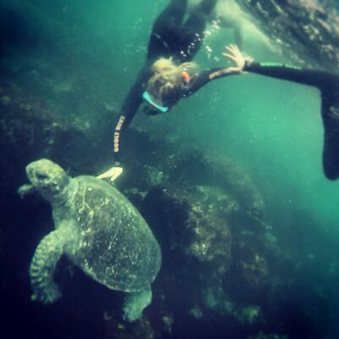



Organisers and facilitators
Members of the movement ecology special interest network (MoveSIN)
Mitchell Cowan
Niraj Meisuria
Rhys Cairncross
Sally Burgemeestre
Thomas Newsome
Lily Bentley
Scott Forrest

Slide 4
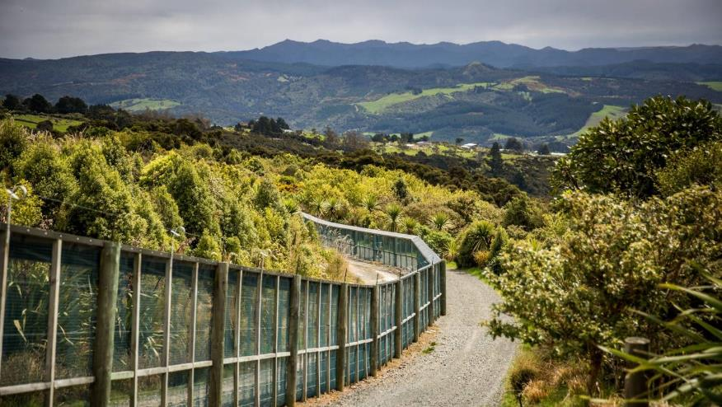
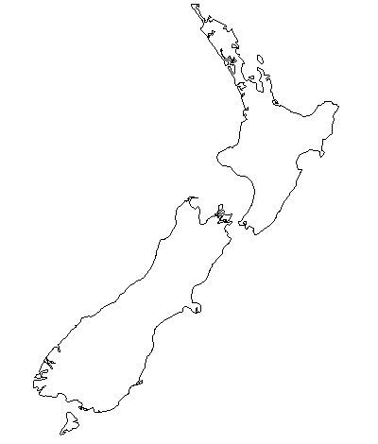
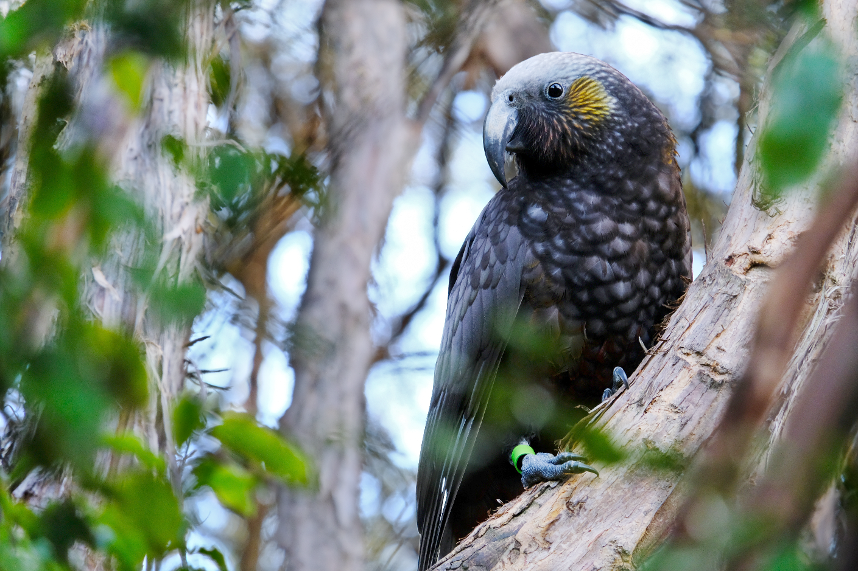
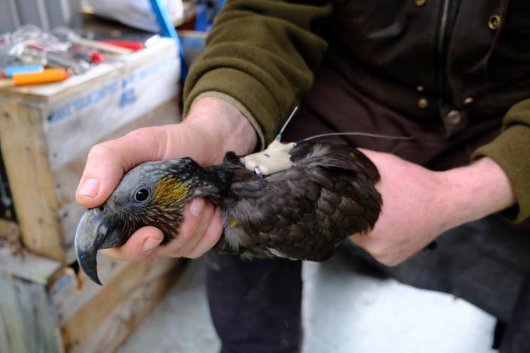
Kākā (Nestor meridionalis)
Notes:
Nationally vulnerable

Slide 5
Animal movement ecology
Space use
Resource selection
Behavioural classification
Visualisation

Slide 6
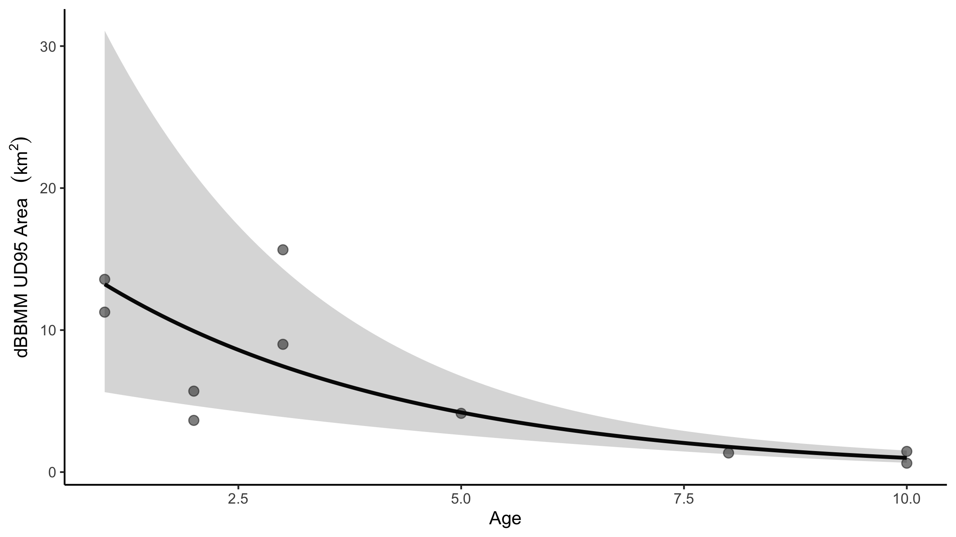
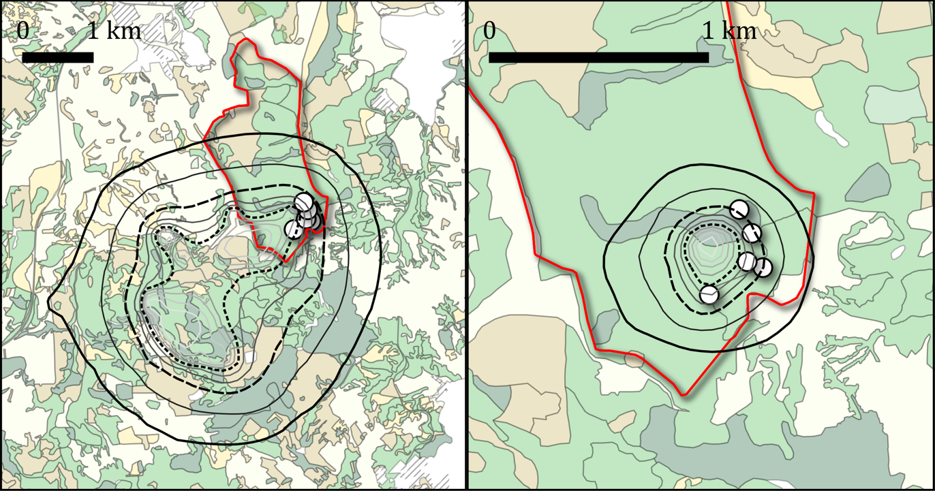
p = 0.0015**
R² = 0.77

Slide 7
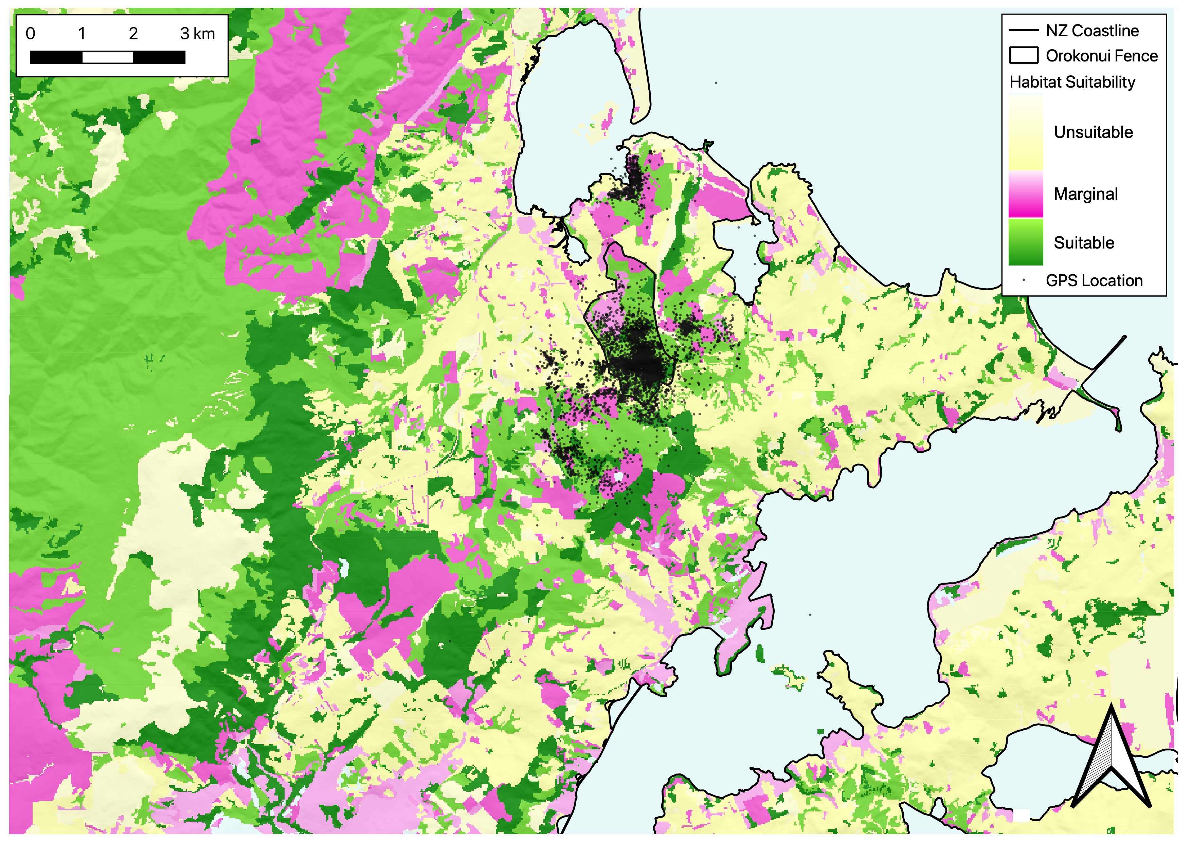

Slide 8
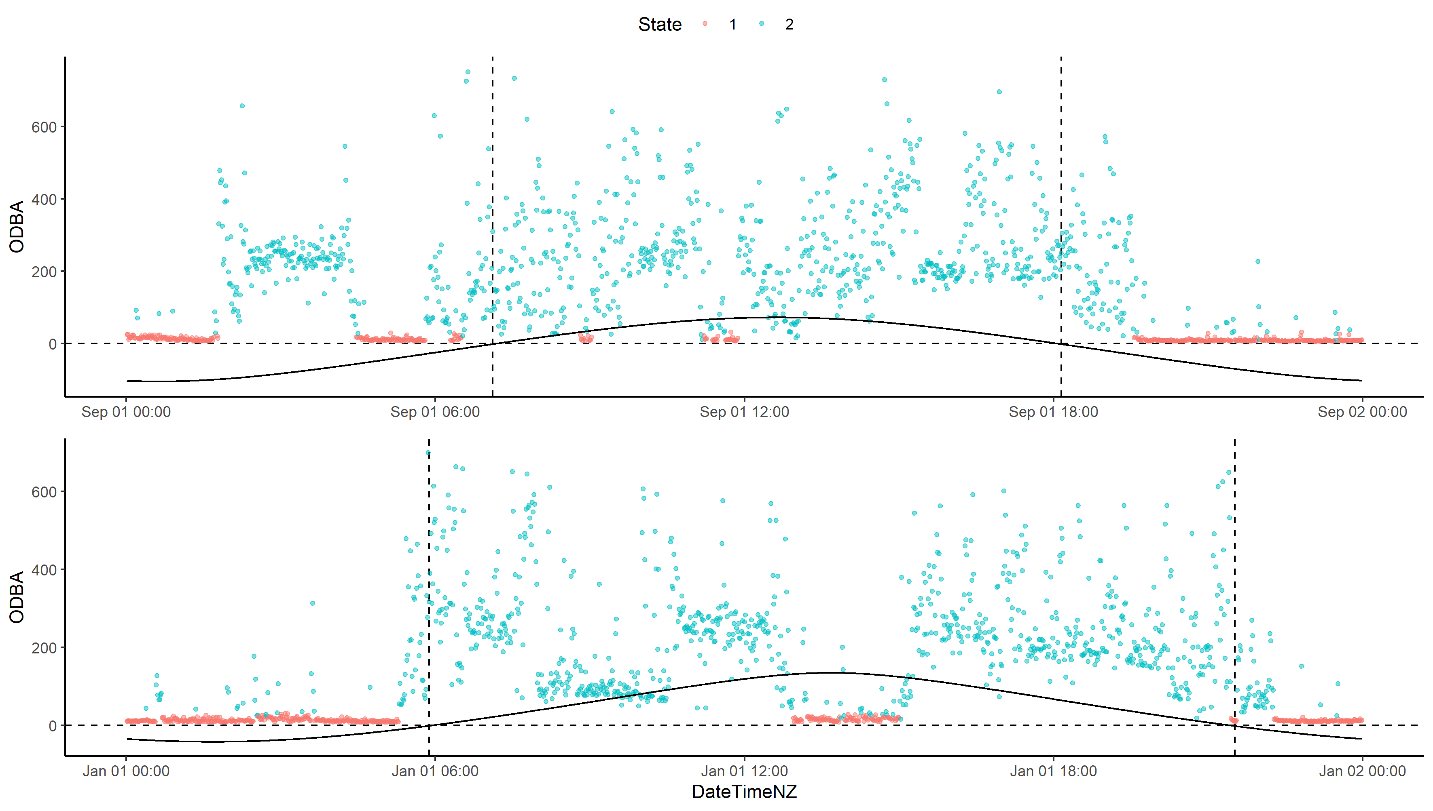
September 1st 2020
January 1st 2021

Slide 9
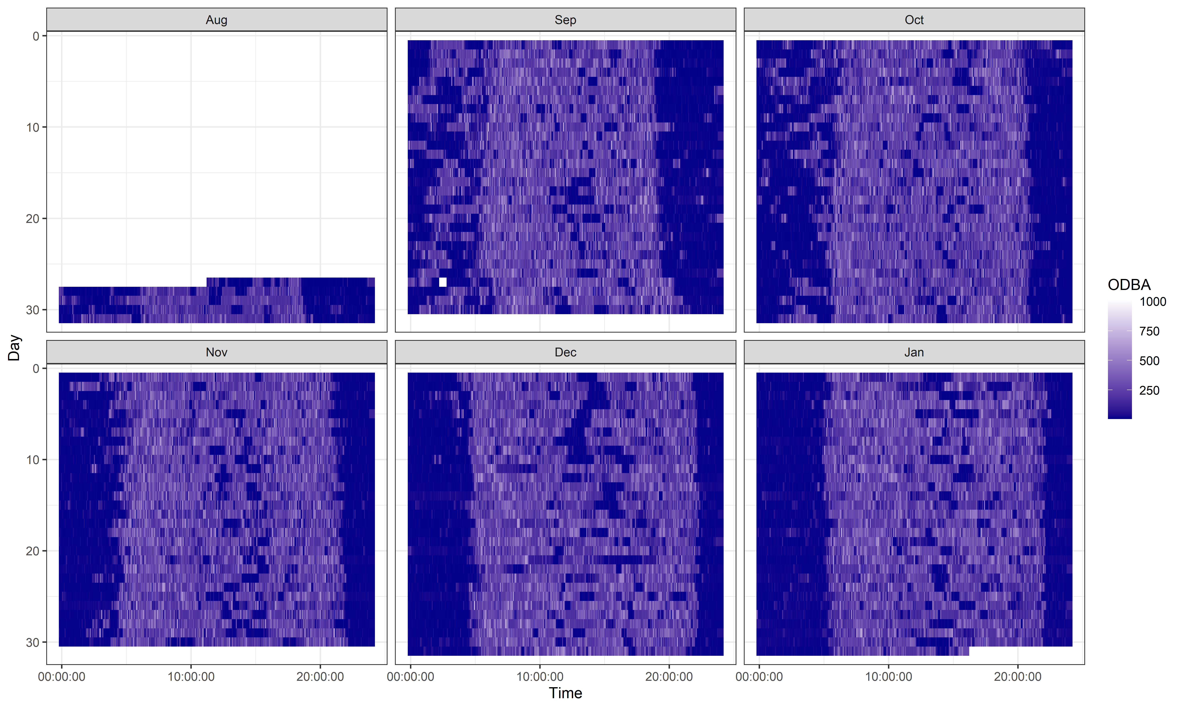

Slide 10
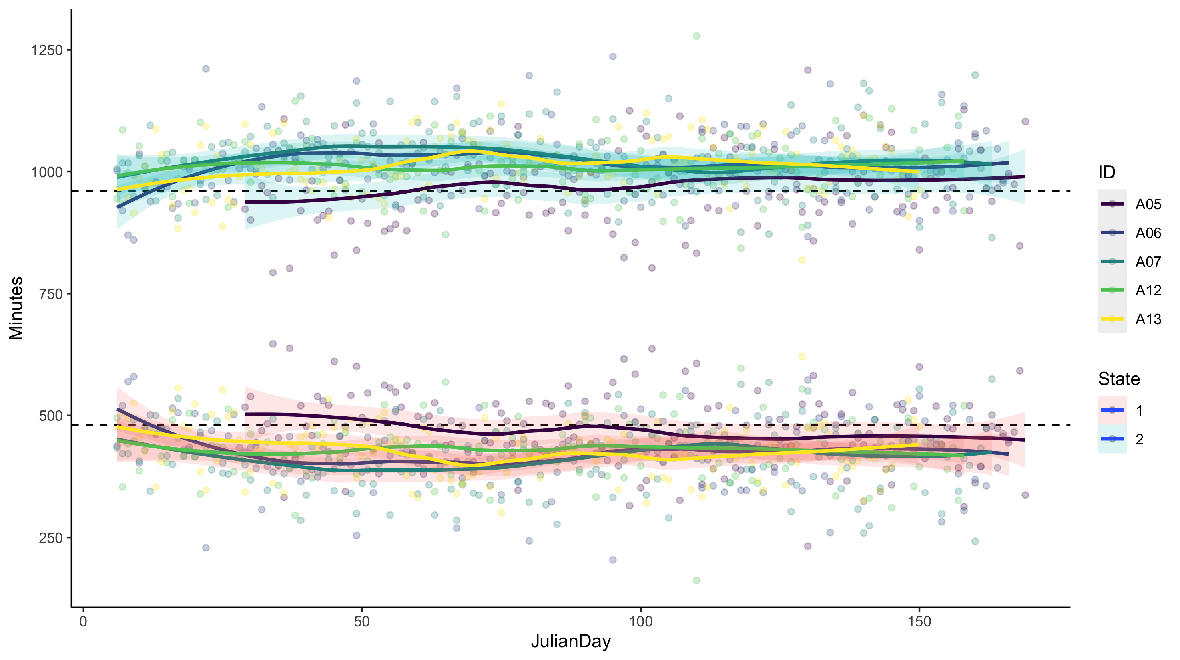






Notes:
Loess smoothing – locally weighted scatterplot smoothing

Slide 11
Understanding and predicting animal movement
Understanding where animals are in space and predicting where they will go is a cornerstone of ecology and management
threatened species
invasive species

Slide 12
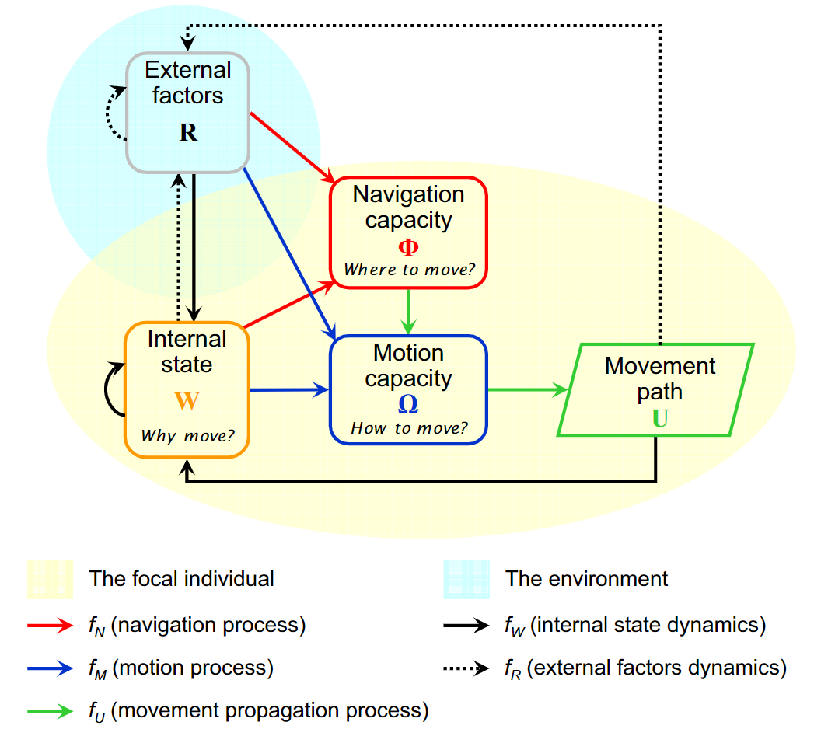
Animal movement – what drives it?
Nathan et al (2008)
external factors
resources
abiotic factors
other animals
internal state
sex
age
memory
energetic status
breeding status
all we get is location data
Notes:
resources include predominately food for the animal
abiotic factors include temperature, solar exposure, the distribution of water
other animals may be conspecifics, or other species, which is particularly obvious in predator-prey dynamics
All we can gather from animals is their locations over time and other behavioural information.

Slide 13
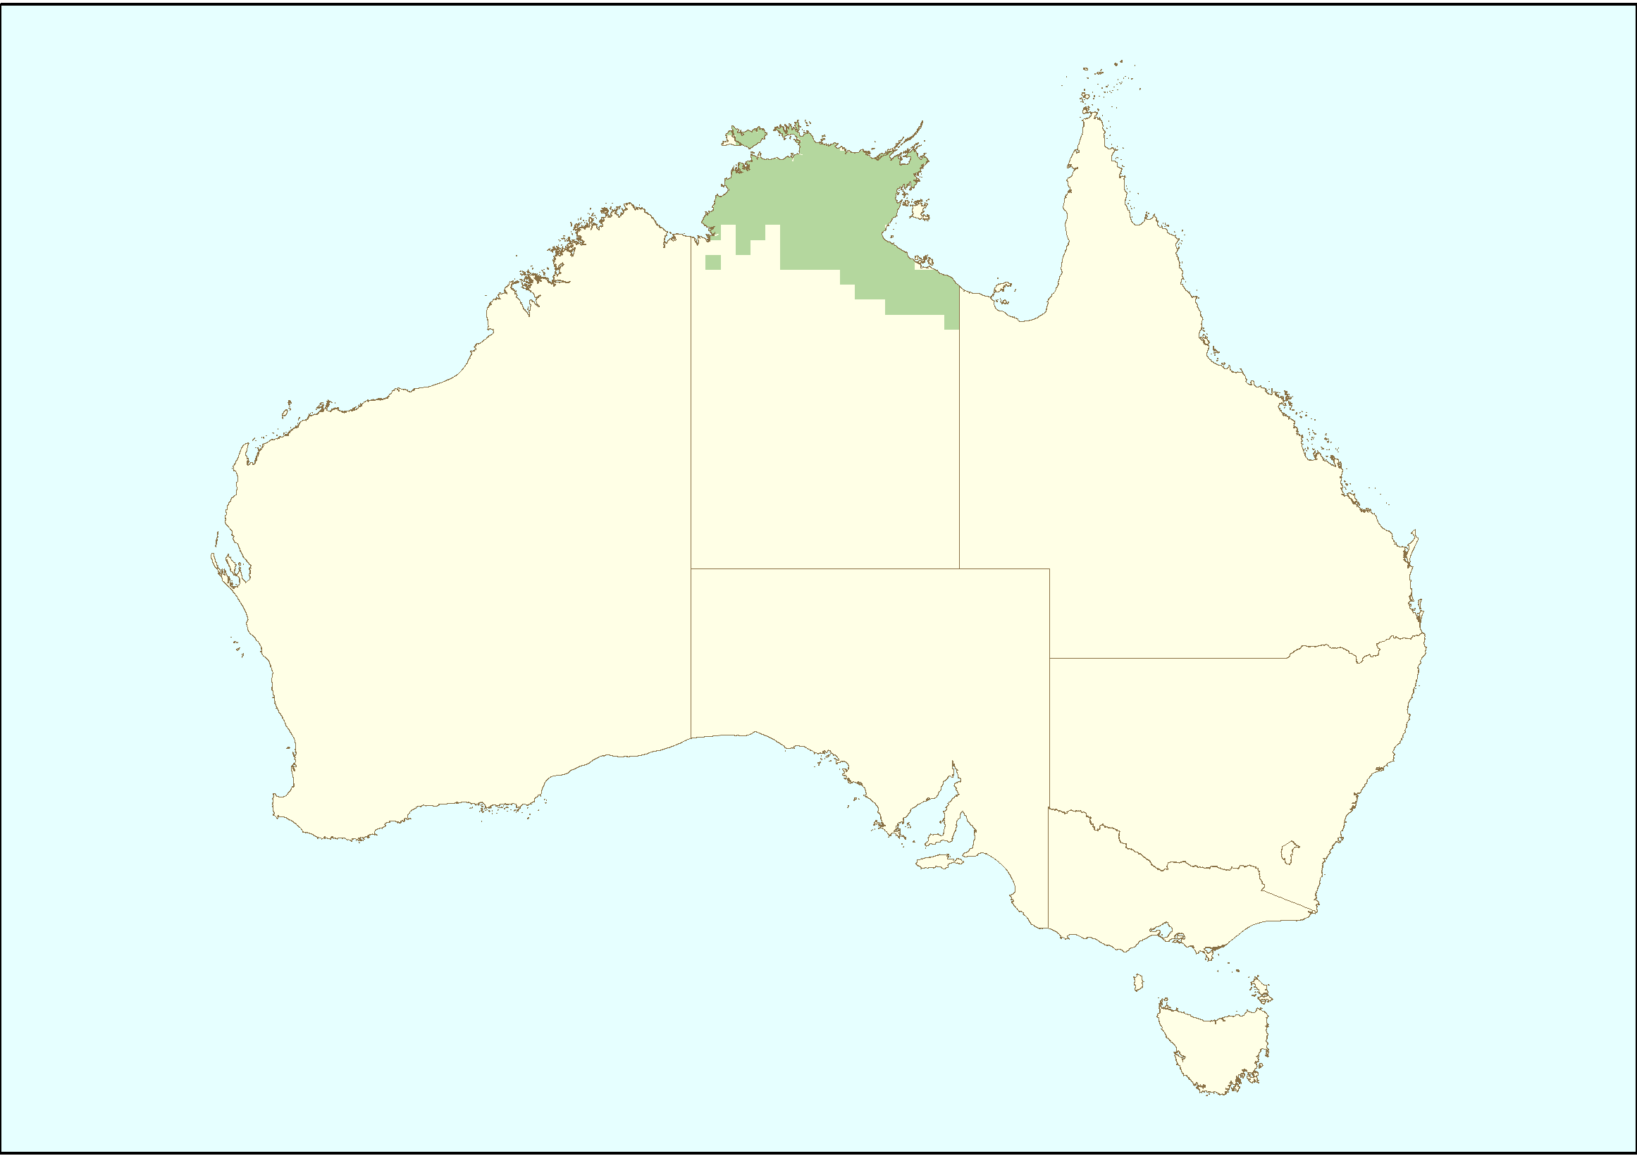
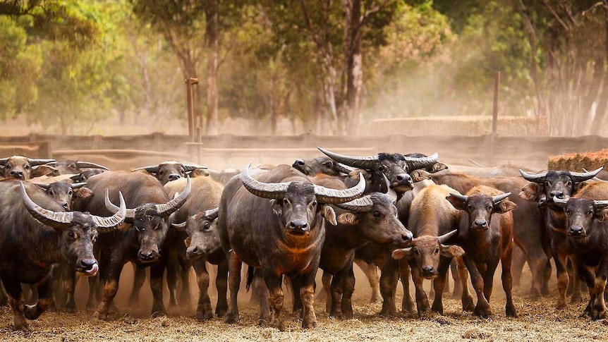
Case study – feral herds in Northern Australia
Asian water buffalo and feral cattle
Cause significant land degradation
Are vectors for various diseases
Management includes
on-ground mustering
aerial shooting
Need to have accurate spatial and temporal information
dynamic behavioural changes throughout the day and seasons
Source: DSEWPaC (2010) Feral animals on offshore islands database at http://www.environment.gov.au/biodiversity/invasive/ferals/islands/index.html
Asian water buffalo (Bubalus bubalis)
Notes:
Management of these pests consists of on-ground mustering for export, or other approaches like aerial shooting. These methods require detailed and up-to-date knowledge of their whereabouts both spatially and temporally across the vast landscapes.
This is complicated by dynamic behavioural changes in the bovids both seasonally and daily, the important influence of social dynamics on their movement, as well as the potential for rapid changes in environmental conditions such as flooding during the wet season.
Ideally, to support efficient control of these species, we require approaches that can incorporate behavioural complexity and up-to-date environmental information.

Slide 14
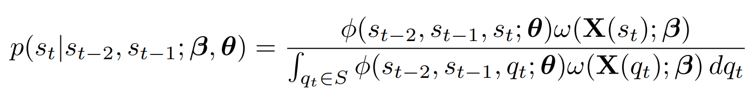
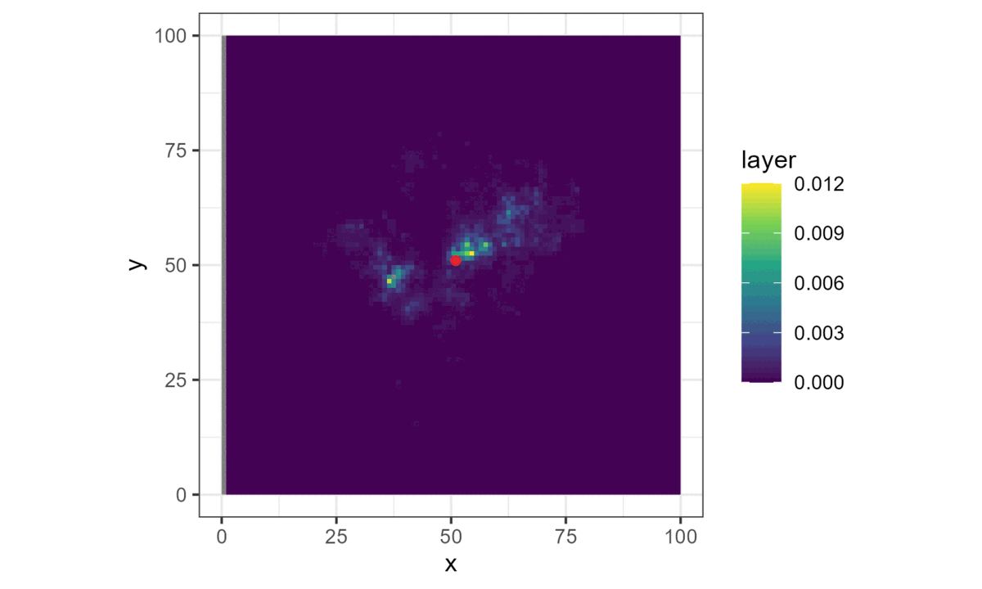

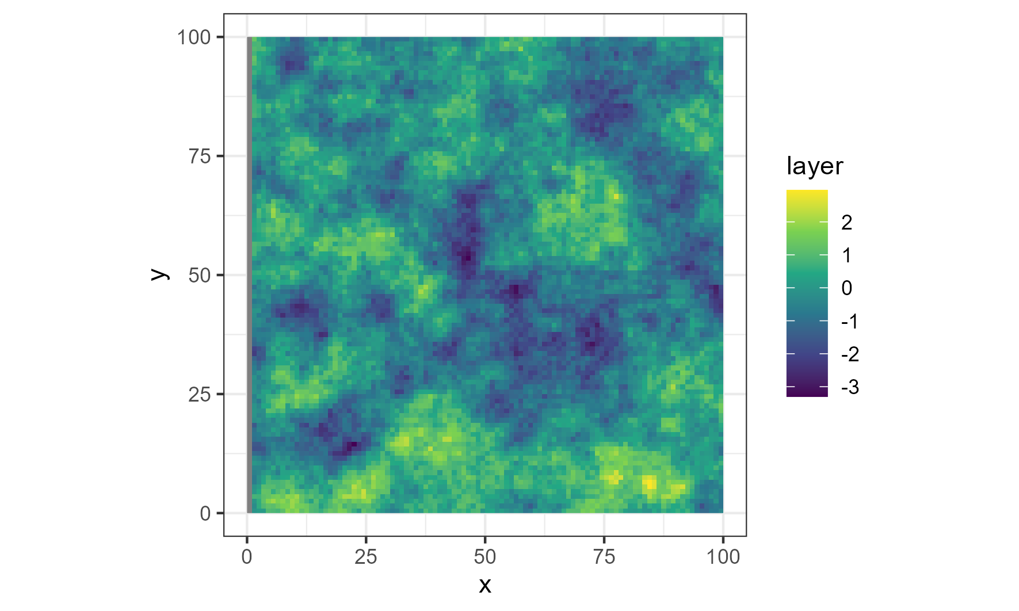
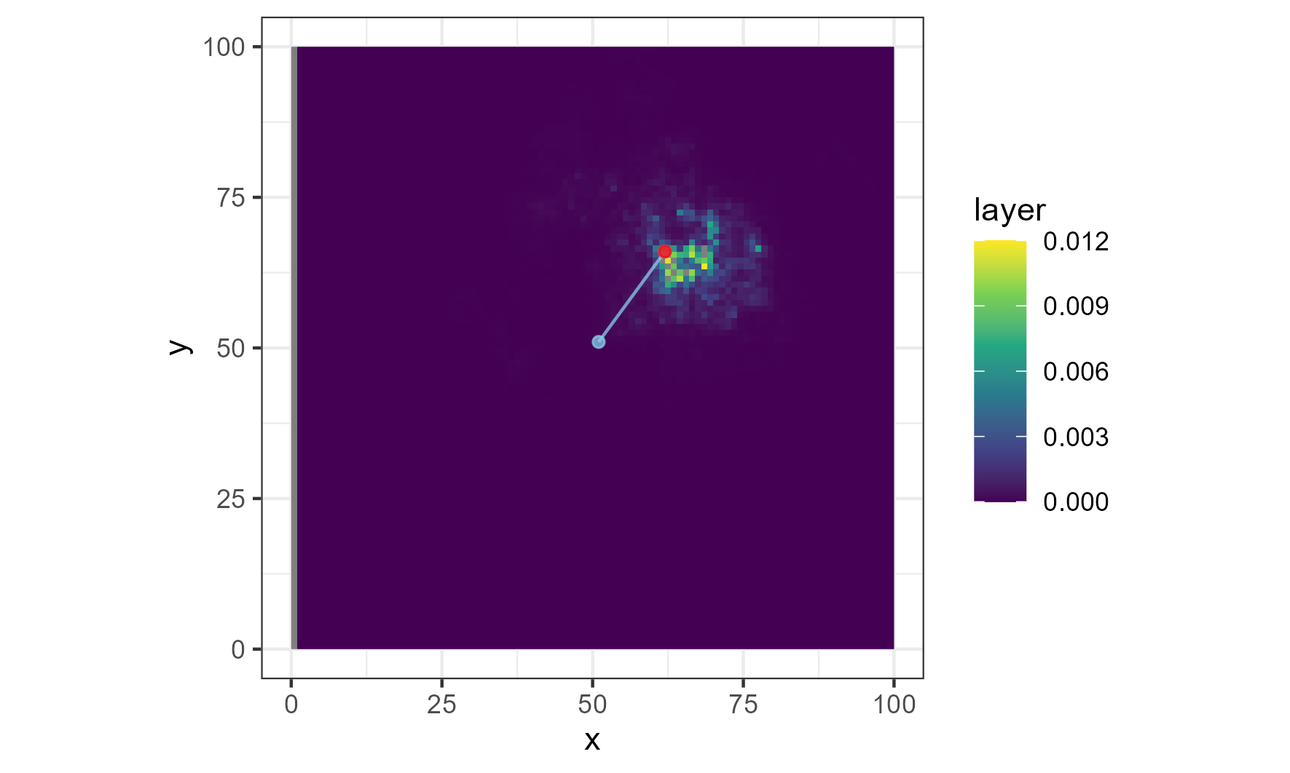
Step selection analysis
movement kernel
habitat selection
probability of next step
Habitat suitability
Probability of next step
High
High
Low
Low

Slide 15
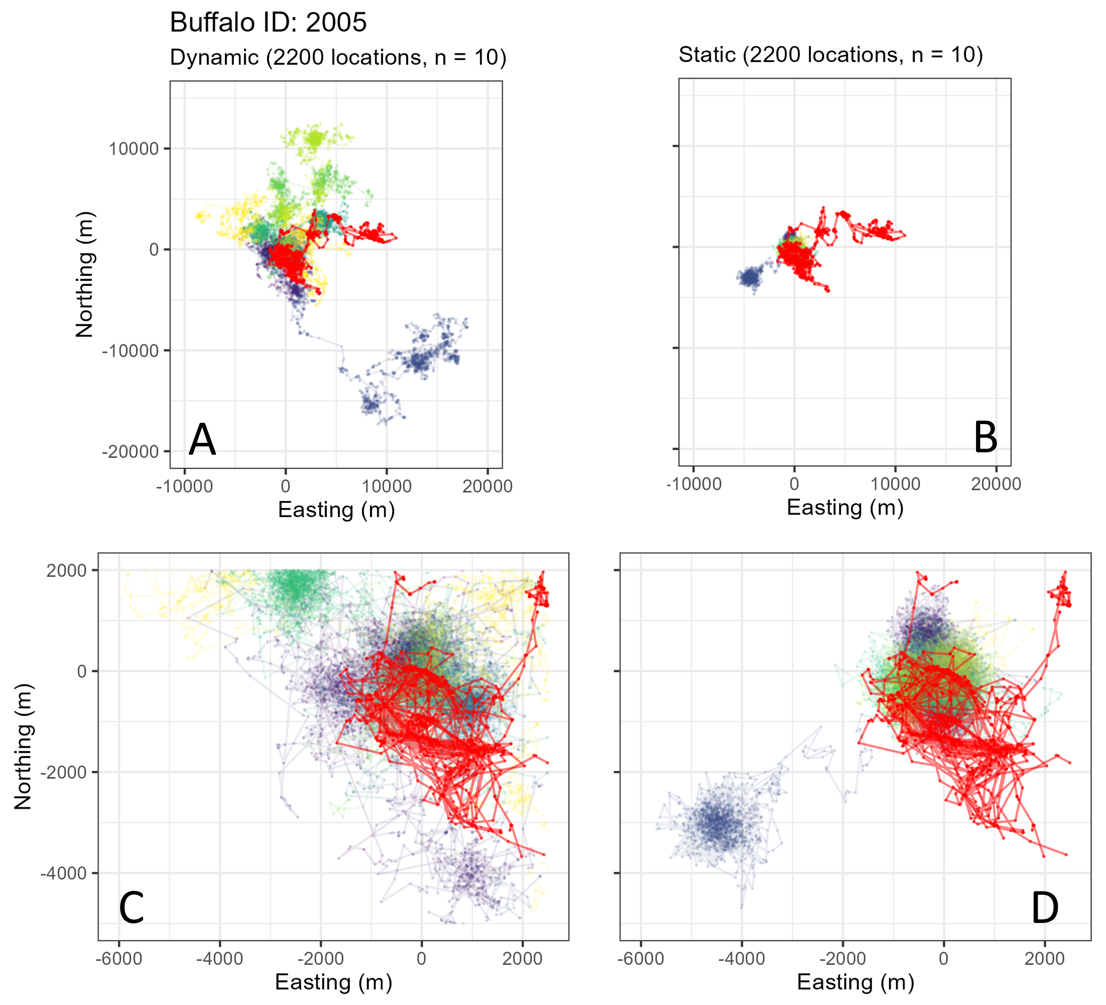

Slide 16
Why it’s limited
Limited flexibility of responses
Multiscale temporal dynamics difficult to fit and interpret
Interactions between covariates difficult to fit and interpret

Slide 17
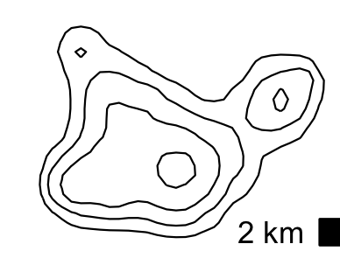
Habitat covariates
Neural network
Probability of next step
High
Previous location density
Low
Hour of the day: 13
Day of the year: 271
Notes:
we hope to capture the true complexity that’s present within animal movement

Slide 18
Benefits
Neural networks are very flexible functions that capture non-linear responses
Interactions between all inputs are considered
More suited to capture the true complexity present within animal movement
May be possible to further understand animal movement

Slide 19
Data
GPS trackers deployed in August/September 2022 on
400 water buffalo in Arnhem Land
516 feral cattle in Cape York
A range of sexes and ages
Both within and between clan groups

Slide 20
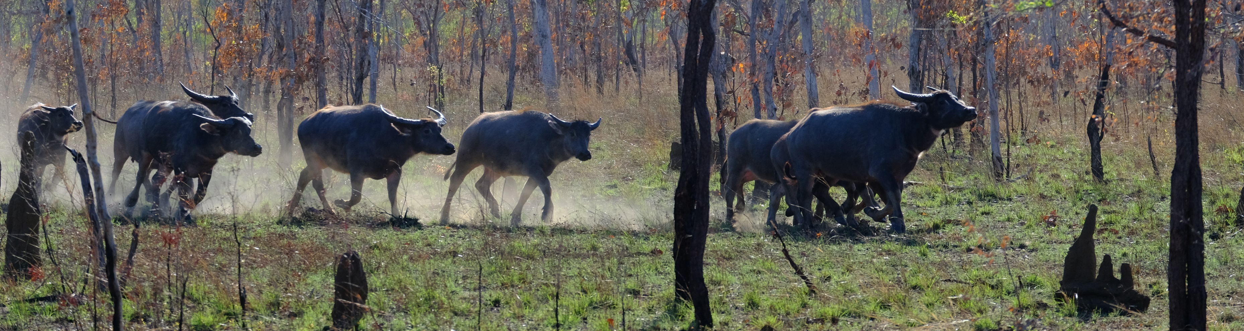
Thanks for listening
scott.forrest@hdr.qut.edu.au
Nathan, Ran, Wayne M. Getz, Eloy Revilla, Marcel Holyoak, Ronen Kadmon, David Saltz, and Peter E. Smouse. 2008. “A Movement Ecology Paradigm for Unifying Organismal Movement Research.” Proceedings of the National Academy of Sciences of the United States of America 105 (49): 19052–59.
Forester, James D., Hae Kyung Im, and Paul J. Rathouz. 2009. “Accounting for Animal Movement in Estimation of Resource Selection Functions: Sampling and Data Analysis.” Ecology 90 (12): 3554–65.

